Slide 1
Refining a Tool to Measure Individual and Collective Skill Retention
2021-01-10
Job Talk Presentation
Dr. Matthew D Wood
Research funded by the U.S. Army Research Institute under contract W911NF-18-D-0003

Slide 2
PRESENTATION OUTLINE
About me [3 min]
Project Overview [8 min]
Roles [3 min]
Method [8 min]
Findings [5 min]
Consequences of Research [5 min]
Lessons learned [10 min]
Questions [5 min]

Slide 3

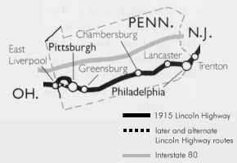
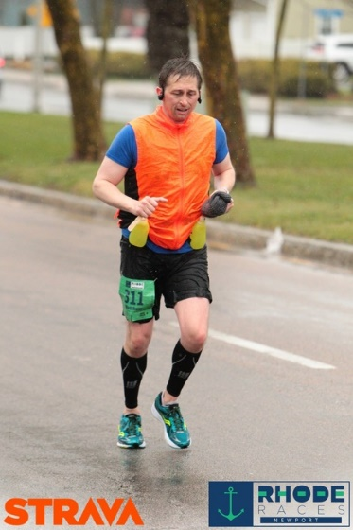




About me
Research Interests
Apply methods from decision analysis, operations research, data science, and behavioral research to improve understanding of problem solving processes and support decision making across individuals, teams, and organizations.
Education and Experience
Senior Scientist, Aptima Inc., Performance Assessment Technologies
Research Psychologist, U.S. Army ERDC, Risk & Decision Science Team
Ph.D, Cognitive Psychology, Carnegie Mellon University
M.S., Psychology (I/O Focus), Villanova University
B.A., Psychology, Elizabethtown College
Personal Interests
Running, Fantasy Sports, R, Old Buildings
Notes:
http://clipart-library.com/clipart/1304326.htm
http://lincolnhighway.jameslin.name/by_state/pa.html
https://www.redfin.com/MA/Salem/145-Federal-St-01970/home/8378866
https://rstudio.github.io/reticulate/

Slide 4
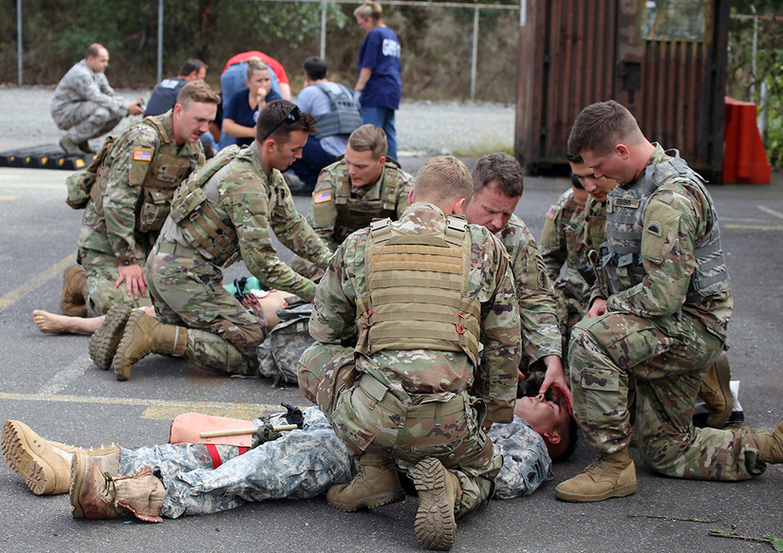
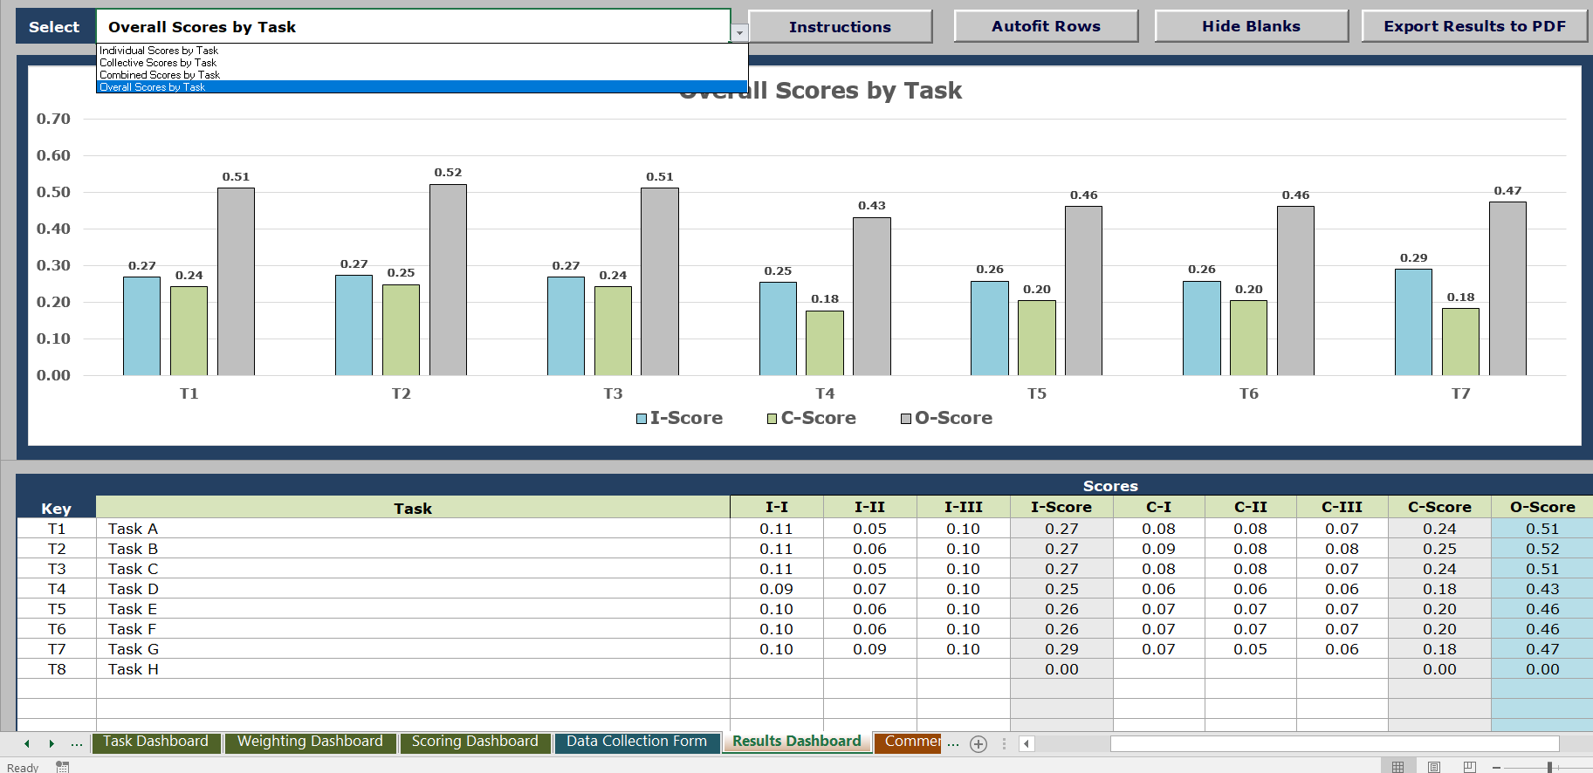
Project Overview
Validate the Trainer’s Decision Aid (TDA; Cianciolo et al., 2010) with data from Tactical Combat Casualty Care (TC3) course participants (trainers & students)
Develop TDA Electronic Scoring Tool (TDA-EST) to enable trainers & commanders to better schedule training and develop curricula for key skills.

Slide 5
Project Overview: Key Concepts
Project Concepts
Trainer’s Decision Aid (TDA)
26-item measure of the extent to which a skill will be maintained once trained
Considers task characteristics, unit characteristics, & external factors
Scales for individual & collective skills
Tactical Combat Casualty Care (TC3)
Course which trains students to apply trauma first aid for common battlefield injuries
Required every 3 years, or within 12 months of an upcoming deployment
Combat Casualty Assessment (CCA)
Hands-on test at the end of the TC3 course
Fail if 1-of-9 critical items are missed, or if over allotted time on one of 4-5 tasks
Memory & Learning Concepts
Skill Retention
The extent to which a skill is maintained after a training or rehearsal opportunity
Inverse of skill decay
Proficiency [magnitude]
The extent and quality to which a learner can perform a skill
Readiness [criterion]
The ability for a learner to perform a skill when called upon to do so

Slide 6
Project Overview: Why?...
Why use the TC3 course for validation data? Why not another skillset?
The customer has a strong relationship with the unit that conducts this training
Co-located at Ft. Hood
To maintain readiness, skills need to be practiced more often than the requirement
Why the TDA? Why not another instrument?
Training schedules are driven by regulations and budgets, not science of retention
Simplicity
Introduces a small change to current process
May not have sufficient information needed for a high-fidelity skill decay model (e.g., Anderson et al., 2004; Fausset et al., 2017)
Continues a line of research started in the customer’s division > 10 years ago

Slide 7
Roles
Me
Principle Investigator
Lead research efforts
Work with customer to develop & implement study design
Lead data analysis and result reporting
Lead development of the TDA-EST
Project Manager
Monitor project spending
Coordinate effort of project team members
Ensure deliverables are delivered to the customer in a timely fashion
Aptima Research Staff
Conduct literature review
Implement TDA-EST
Support analysis
Medical Simulation Training Center (MSTC)
Stakeholder
Provide subject-matter expertise
Provide trainer & student participants for data collections
Army Research Institute, Ft. Hood
Customer
Maintain relationship with MSTC
Coordinate trainer data collection
Request and curate student data
Notes:
http://tennesseecpr.com/wp-content/uploads/2020/03/TCCC.jpg

Slide 8
Method
Two-pronged approach planned
Instrument calibration
TDA Expert Sample
Completed paper version of the TDA & holistic measure of skill decay
CCA Student Sample
Calibration data from TC3 courses
Students take the CCA to certify, some asked to return 2-6 months later to estimate retention
Tool development
TDA Expert Sample
Questions about their experience completing the paper version, and the task of training TC3 skills
Literature review
Clarify TDA item text in response to confusion expressed in expert sample
Identify recommended applications for using TDA, and intervention suggestions to complement scores
Creation of TDA-EST in macro-enabled Excel workbook

Slide 9
Method: Schedule
Task | Q1 FY 19 | Q2 FY 19 | Q3 FY 19 | Q4 FY 19 | Q1 FY 20 | Q2 FY 20 | Q3 FY 20 | Q4 FY 20 | Q1 FY 21
BASE YEAR
Task 1. Prepare R&D Plan/Manage Contract
Task 2. Use the TDA to assist in predicting and examining individual/collective skill acquisition and retention
Task 3. Conduct research on skill acquisition and retention of critical individual/collective tasks
OPTION YEAR
Task 4. Provide a User’s Guide (ARI Research Product)
Task 5. Provide a set of recommendations to update frequency of task training
Task 6. Conduct exploratory research (including literature reviews)
Task 7. Document research results in an ARI Technical Report

Slide 10
Method: Schedule
Task | Q1 FY 19 | Q2 FY 19 | Q3 FY 19 | Q4 FY 19 | Q1 FY 20 | Q2 FY 20 | Q3 FY 20 | Q4 FY 20 | Q1 FY 21
BASE YEAR
Task 1. Prepare R&D Plan/Manage Contract
Task 2. Use the TDA to assist in predicting and examining individual/collective skill acquisition and retention
Task 3. Conduct research on skill acquisition and retention of critical individual/collective tasks
OPTION YEAR
Task 4. Provide a User’s Guide (ARI Research Product)
Task 5. Provide a set of recommendations to update frequency of task training
Task 6. Conduct exploratory research (including literature reviews)
Task 7. Document research results in an ARI Technical Report
COVID-19
Limited ability to develop retest data
Restricted availability of trainer staff or other SMEs
Created hard requirement to finish contract on-time
No palette for NCE w/ budget uncertainty
Shrinking tax base shrinks budgets

Slide 11
Method: Research Samples
We collected data from two samples to better understand the usability of the TDA and how it might be calibrated.
TDA Expert Sample
33 Trauma Combat Casualty Care (TC3) course instructors & experts
Completed the paper form of the TDA, along with readiness assessments, and demographic information related to TC3 expertise (e.g., time in service, MOS, etc)
Provided feedback on TDA usability
Described challenges in training students on TC3 skills
Combat Casualty Assessment (CCA) Student Sample
253 students completing the TC3 course
Assessed on TC3 skill performance
Provided demographic information related to TC3 expertise

Slide 12
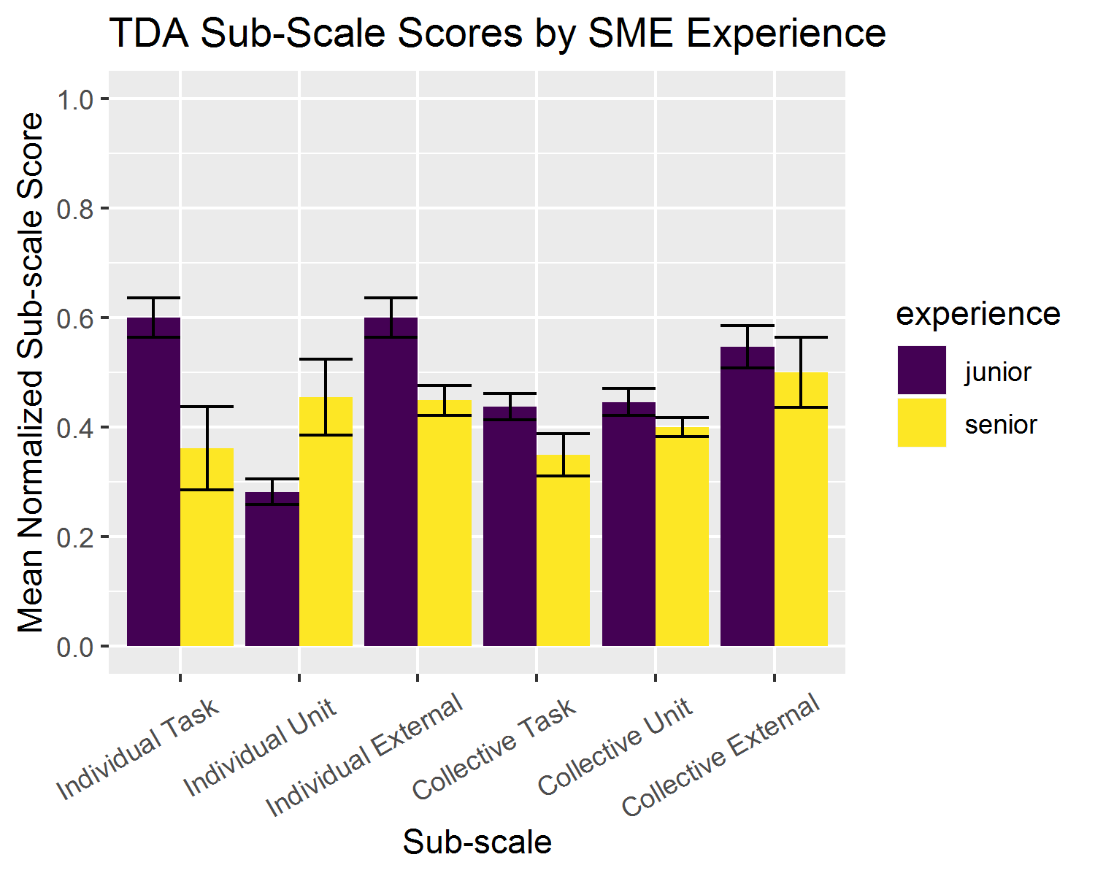
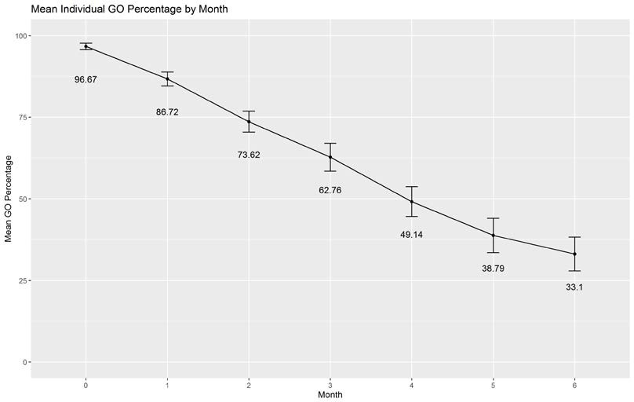
Findings: TDA Expert Sample
Experts reported perceived readiness to decay linearly over time
Experience effects
Those with fewer than 8 yrs experience thought Individual Unit Characteristics were the most influential in retaining TC3 skills
Nonsignificant effect of experience on TDA scores in general
TDA sub-scale scores did not correlate with these readiness judgments
In interviews, experts reported that years of experience and rank were valuable as indicators of expertise in predicting student success in the TC3 course, and also as indicators of motivation.

Slide 13
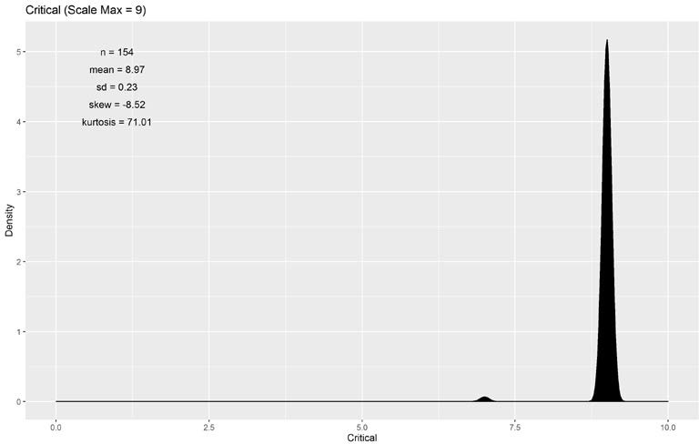
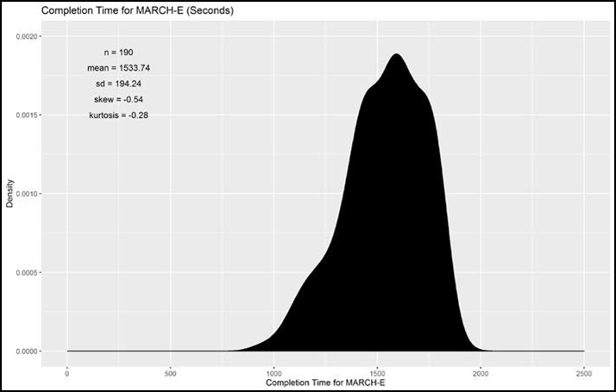
Findings: CCA Student Sample
Most CCA measures (critical item score, MARCH-E completion time) were lyptokurtic and had a long left tails, common for research using criterion measures
Restriction of range
Rank was associated with CCA pass rate on the first attempt
PVT/PV2/PFC (n=113) passing: 68.1%
SPC+ (n=118) passing: 81.3%

Slide 14
Consequences of Research: TDA-EST Design
Knowledge gained from both samples, particularly discussions of usability of the TC3 and challenges in teaching medical skills, were used to develop the TDA-EST. The tool is intended to make completing the TDA easier and produces decay curve estimates that can be used to plan training schedules or develop course curricula.
TDA-EST was developed using principles from Multi-Criteria Decision Analysis (Keeney & Raiffa, 1976; Rycroft et al., 2019) to enable us and future users to make changes over time that align with user preferences, and task-specific considerations (i.e., item phrasing, calibration data).
Task Dashboard – stores the names of specific tasks (≤14) to assess with TDA
Weighting Dashboard – allows decision makers to express priorities & preferences
Scoring Dashboard – provides updates to item-level responses & scoring
Task Evaluation Form – provides responses to TDA items for each task
Results Dashboard – displays overall & subscale scores, compare scores for tasks
Comments Dashboard – displays any comments provided during task evaluation
Skill Retention Dashboard – displays retention given TDA score and initial proficiency

Slide 15
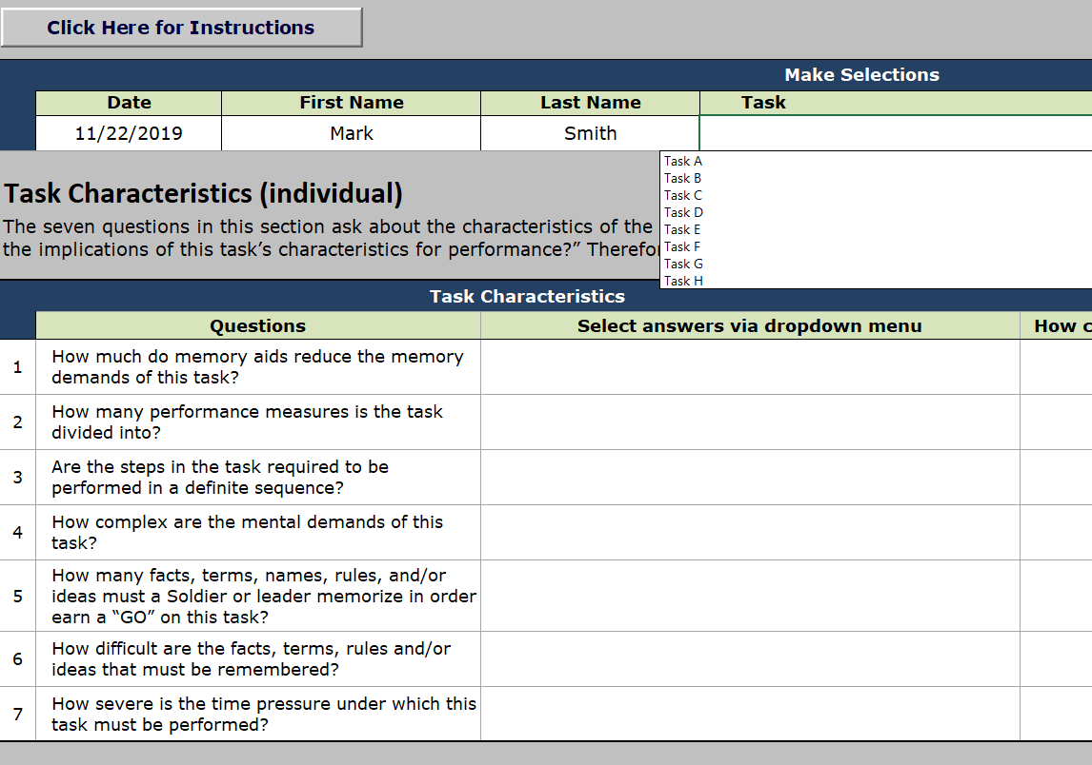
Task Evaluation
Step 1: Enter Date, Name, and Desired Task to Rate
 | Enter current date in the following format (MM/DD/YYYY). Enter your first name and last name. Select the desired task from the Task Dropdown.
1
2
1
2
3
3

Slide 16
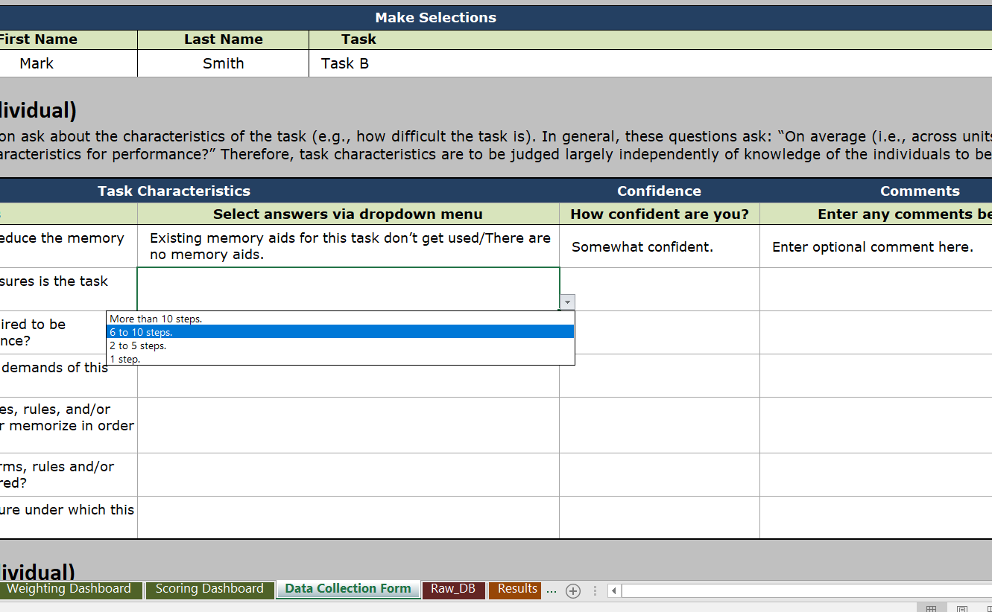
Task Evaluation Step 2: Rate Task on All Criteria
 | For each criterion, select the desired option from the dropdown menu. To view rating guidance for a particular criterion, double click on the corresponding question text. Select a confidence rating from the Confidence column. Enter an optional comment in the Comments column. Repeat the rating process for the remaining criteria. Scroll down to see all scales.
1
2
1
2
3
To view rating guidance, double click in the “Questions” column
3
4

Slide 17
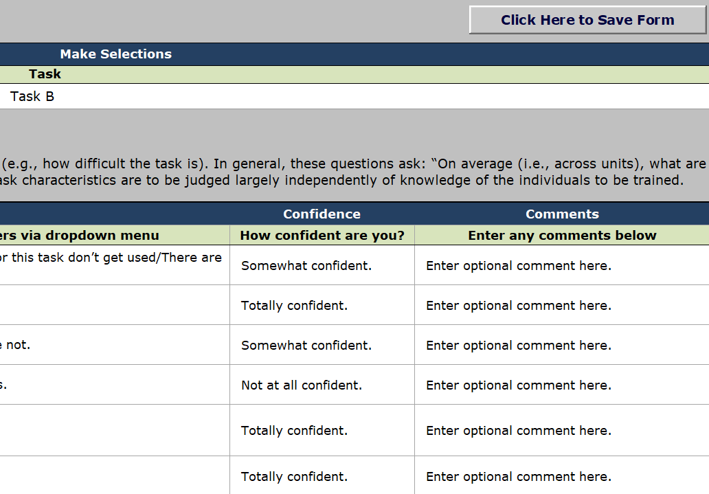
Task Evaluation Step 3: Save Ratings to Database and Repeat
 | To save ratings to the database, click the “Click Here to Save Form” button in the top, right-hand corner of the form. The form will clear. To rate another task, select the desired task from the Task Dropdown and repeat the rating process.
1
1
2
2

Slide 18
Results Step 1: Select Chart and Export Results for Printing
 | Select the desired chart from dropdown menu in the top, left-hand corner of the tab. The chart area will dynamically update based on your selection. To ensure all tasks are fully visible for printing, click the “Autofit Rows” button. To hide blank rows in the table for printing, click the “Hide Blanks” button. To export the contents of the tab to a PDF for printing purposes, click the “Export Results to PDF” button.
1
1
2
3
4
2
3
4

Slide 19
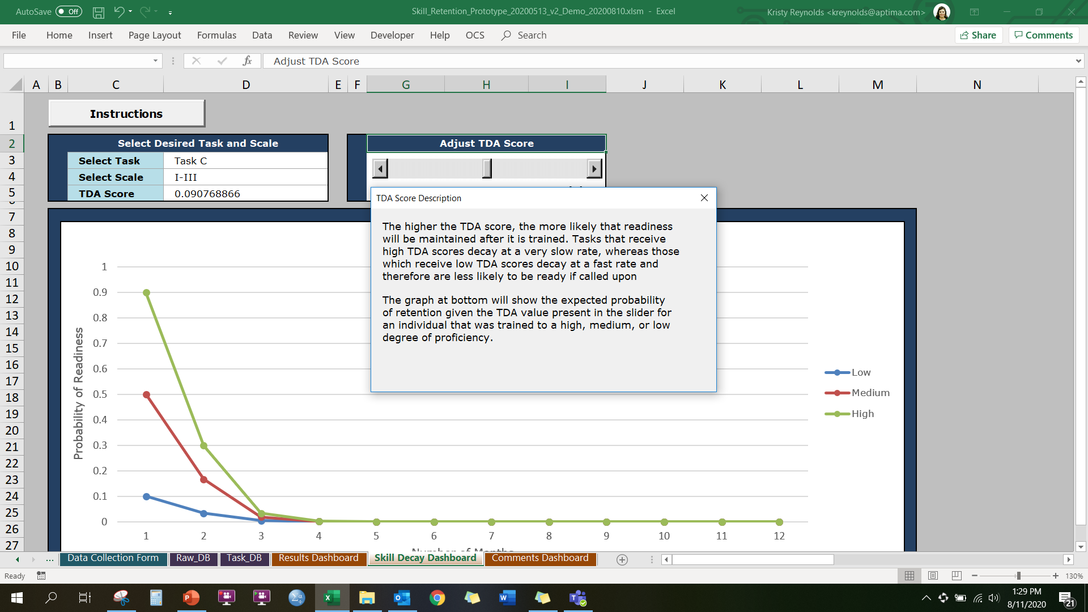
Step 4b: View TDA Score and Chart Descriptions
1
 | To view a description of the TDA Scores and graph below, double click on the “Adjust TDA Score” header. A pop-up will appear.
1

Slide 20
Consequences of Research
Prototype TDA-EST
Test/retest data are still needed to calibrate
TDA-EST User’s Guide (ARI Research Product)
Revising based on technical reviewer comments
ARI Technical Report
Summary of project, including context and motivation for TDA-EST
Recommendations for using scores, interventions

Slide 21
Lessons Learned: What to improve with ~6 months…
Develop a clearer understanding of starting point [< 1 month]
There was no scoring key for the instrument
What was framed as a validation task became calibration
Ask expert sample questions about proficiency measurement in U.S. Army in general, as opposed to the TC3 task specifically
Find a better dataset [1-2 months]
Identify courses/skills with continuous measures
Ideally those not required for certification
e.g., marksmanship practice, PE training v. certification times
Procure administratively (vs. through tight coordination with stakeholder) if possible

Slide 22
Lessons Learned: Continued
Reach out to the original authors sooner [1-2 months]
Made our best guess on how items should be scored
Was able to connect with Cianciolo in the last few weeks of the project
By the time we connected, it was too late to revise/rerun analyses or ask her to reconstruct the reasons for certain design decisions
More rigorous factor or cluster analysis of data in-hand [1 month]
Given resources and data quality, we focused on correlating subscale scores with a concurrent validation measurement before investigating further
May be that some parts of scales/subscales correlate strongly w/ concurrent measure, currently unkown
Develop a recruiting plan which increases odds that students return for retest [1 month]
No incentive to return to MSTC once certification is attained
MSTC is in the business of executing training, not conducting research

Slide 23
Questions?

Slide 24
References
Anderson, J. R., Bothell, D., Byrne, M. D., Douglass, S., Lebiere, C., & Qin, Y. (2004). An Integrated Theory of the Mind. Psychological Review, 111(4), 1036–1060. https://doi.org/10.1037/0033-295X.111.4.1036
Cianciolo, A. T., Crabb, B. T., Schaefer, P., Jackson, S., & Grover, J. (2010). Sustainment of individual and collective future combat skills: Modeling and research methods. Army Research Institute for the Behavioral and Social Sciences.
Fausset, C. B., Cheng, S., Trani, A. N., Hutto, C. J., Hale, C. R., McDermott, T., Nadolski, M., & Folds, D. J. (2017). Developing a Model of Team Skill Decay. Proceedings of the Human Factors and Ergonomics Society Annual Meeting, 61(1), 735–739. https://doi.org/10.1177/1541931213601669
Keeney, R. L., & Raiffa, H. (1976). Decision with multiple objectives. Wiley, New York.
Rycroft, T., Wood, M., Zemba, V., Kennedy, A., Weiss, C., Desmet, D., Ali, R., & Linkov, I. (2019). Assessing the sustainability of advanced materials using multi criteria decision analysis and the triple bottom line. Integrated Environmental Assessment and Management.

Slide 25
Matt Wood, Senior Scientist
Aptima, Inc. 12 Gill Street, Suite 1400, Woburn, MA 02 mwood@aptima.com Direct 781-496-2438 Mobile 717-579-9135
www.aptima.com
Christopher Vowels, ARI Team Leader
U.S. Army Research Institute 36000 Darnall Loop, Fort Hood, TX
christopher.l.vowels.civ@mail.mil Direct 254-288-9403 Mobile 254-417-4057

Slide 26
BACKUP

Slide 27
TDA Items

Slide 28
Individual TDA Section I: Task Characteristics
How much do memory aids reduce memory demands for this task?
How many performance measures is the task divided into?
Are the steps in the task required to be performed in a definite sequence?
How complex are the mental demands of this task?
How many facts, terms, names, rules, and/or ideas must a Soldier or leader memorize in order earn a “GO” on this task?
How difficult are the facts, terms, rules and/or ideas that must be remembered?
How severe is the time pressure under which this task must be performed?

Slide 29
Individual TDA Section II: Unit Characteristics
How strongly has the battalion commander emphasized the importance of learning this skill?
How closely did the initial training conditions of this skill match its performance conditions under combat conditions?
How often has this skill been used?

Slide 30
Individual TDA Section III: External Factors
On average, how user friendly are the information displays that are most important to performing this task?
How frequently has the technology involved in performing this task changed?
How reliable is the technology involved in performing this task?
What level of information overload do the Soldiers performing this task typically operate under?

Slide 31
Collective TDA Section I: Task Characteristics
What is the size of the collective that this task applies to?
How complex are the mental demands of this task?
How interdependent are the roles of the people who perform this task?
How severe is the time pressure under which this task must be performed?

Slide 32
Collective TDA Section II: Unit Characteristics
How strongly has the battalion commander emphasized the importance of learning this skill?
How effective was the training on this collective task?
How often has this task (or similar tasks) been performed by the collective?
How much have the SOP applicable to this task reduced the difficulty of coordination?

Slide 33
Collective TDA Section III: External Factors
On average, how user friendly are the information displays that are most important to performing this task?
How frequently has the technology involved in performing this task changed?
How reliable is the technology involved in performing this task?
What level of information overload does the leadership or overall collective performing this task typically operate under?

Slide 34
TDA Development and Extension of UDA
26-item multiple-choice questionnaire to assess skill retention based on Task Characteristics, Unit Characteristics, and External Factors
Separate scales for Individual and Collective tasks
Extends the earlier User’s Decision Aid (UDA, Rose et al., 1985) to better predict performance over time, consider a wider range of tasks, include information about initial skill level, and enable assessment of tasks performed in Individual or Collective contexts

Slide 35
Design
Scoring tool was developed using principles from Multi-Criteria Decision Analysis (Keeney & Raiffa, 1976; Rycroft et al., 2019) to enable us and future users to make changes to the instrument over time that align with user preferences, and task-specific considerations.
Task Dashboard – stores the names of specific tasks (≤14) to assess with TDA
Weighting Dashboard – allow decision makers to express priorities & preferences
Scoring Dashboard – provide updates to item-level responses & scoring
Data Collection Form – provide responses to TDA items for each task
Results Dashboard – see overall & subscale scores, compare scores for tasks
Comments Dashboard – see any comments provided during data collection
Skill Retention Dashboard – see retention given TDA score and initial proficiency

Slide 36
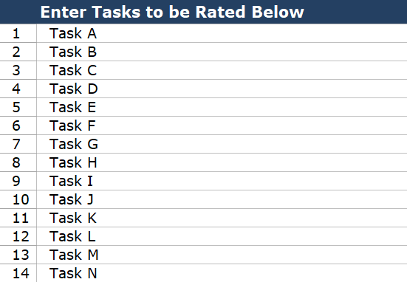
Task Step 1: Enter Tasks in Table on Task Dashboard
 | Enter the first task in row 1 of the table. Enter the second task in row 2 of the table. Repeat until all tasks have been entered. You may add, edit, or delete tasks as needed prior to data collection.
1
1
2
2
3
3
4
4

Slide 37
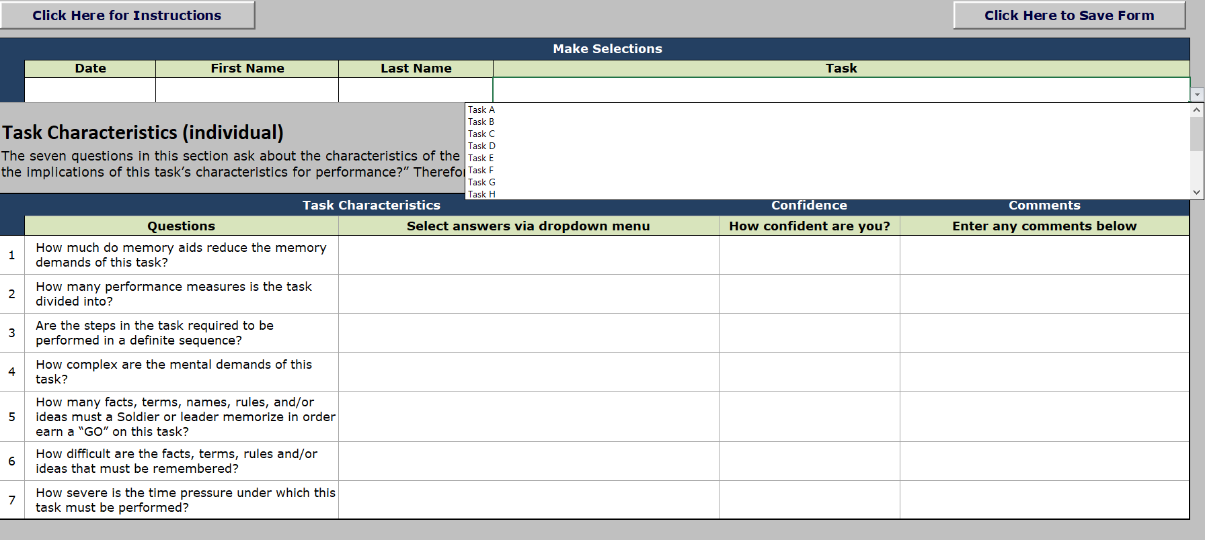
Task Step 2: Tasks Appear in Dropdown on Data Collection Form
Task Dropdown

Slide 38
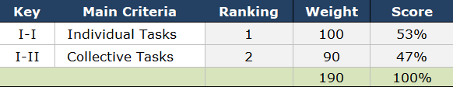
Weighting Step 1: Rank/Weight the Main Criteria
2
 | Rank the Main Criteria in order of importance from 1 to 2 in the Ranking column. Second, give the criterion ranked #1 a weight of 100 points in the Weight column. Third, assign the criterion ranked #2 a weight relative to 100 points (between 0% and 100%). The tool will convert this data into a score (or relative weight) for each criterion in the Score column.
1
1
4
3
2
?
Tips and Notes:
Ranks/Weights: Evaluations should be made within the context of your expert opinion of the criteria’s contribution. Ties are allowed and there is no set total number of points (i.e., the lowest ranked criterion does not have to have a weight of 0).
Changes: The relative weights may be adjusted at any time, including before or after data collection. If the weights are adjusted after data collection, the tool will automatically recalculate existing results based on the new settings.
3
4

Slide 39
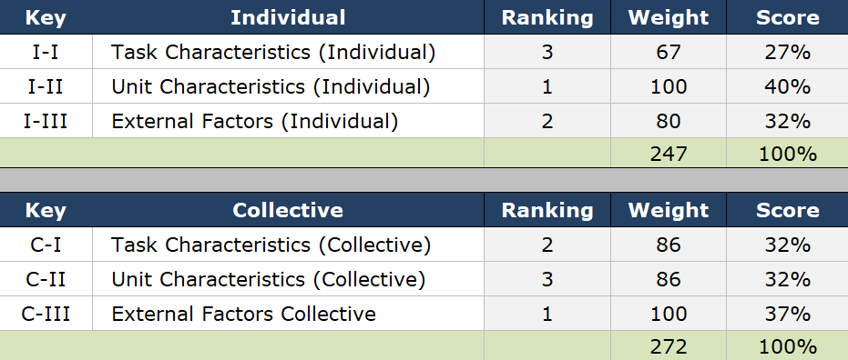
Weighting Step 2: Rank/Weight the Individual and Collective Criteria
 | Individual: Rank criteria in order of importance from 1 to 3. Give the criterion ranked #1 a weight of 100 points. Then, assign the other criteria weights relative to 100 points (between 0% and 100%). Collective: Rank criteria in order of importance from 1 to 3. Give the criterion ranked #1 a weight of 100 points. Then, assign the other criteria weights relative to 100 points (between 0% and 100%).
1
1
2
2
?
Tips and Notes:
Score Column: The tool will convert the ranks/weights into a score (or relative weight) for each criterion.
Ranks/Weights: Evaluations should be made within the context of your expert opinion of the criteria’s contribution. Ties are allowed and there is no set total number of points (i.e., the lowest ranked criterion does not have to have a weight of 0).

Slide 40
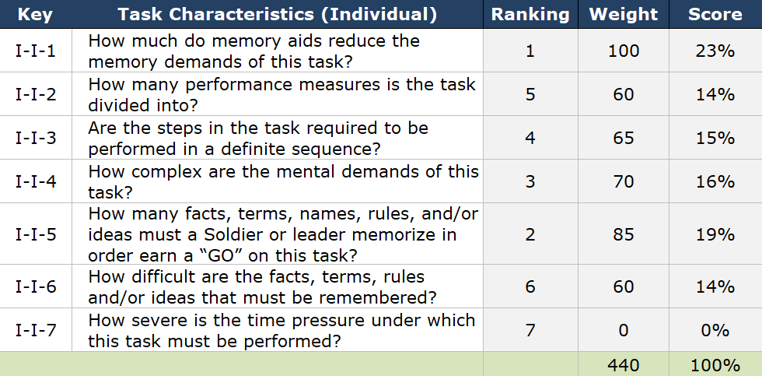
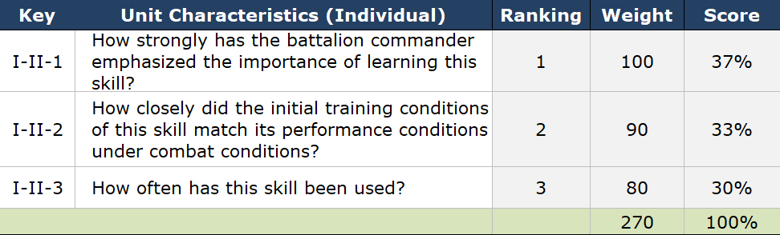
Weighting Step 3: Rank/Weight the Individual Sub-Criteria
 | Task Characteristics (Individual): Rank criteria in order of importance from 1 to 7, and then assign weights. Unit Characteristics (Individual): Rank criteria in order of importance from 1 to 3, and then assign weights. External Factors (Individual): Rank criteria in order of importance from 1 to 4, and then assign weights. (Not Pictured)
1
1
2
3
2

Slide 41
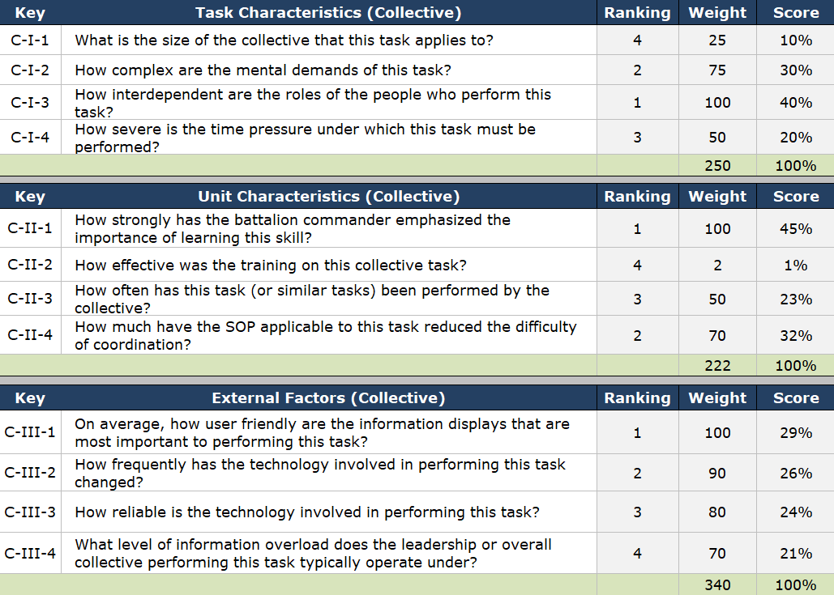
Weighting Step 4: Rank/Weight the Collective Sub-Criteria
 | Task Characteristics (Collective): Rank criteria in order of importance from 1 to 4, and then assign weights. Unit Characteristics (Collective): Rank criteria in order of importance from 1 to 4, and then assign weights. External Factors (Collective): Rank criteria in order of importance from 1 to 4, and then assign weights.
1
1
2
2
3
3

Slide 42
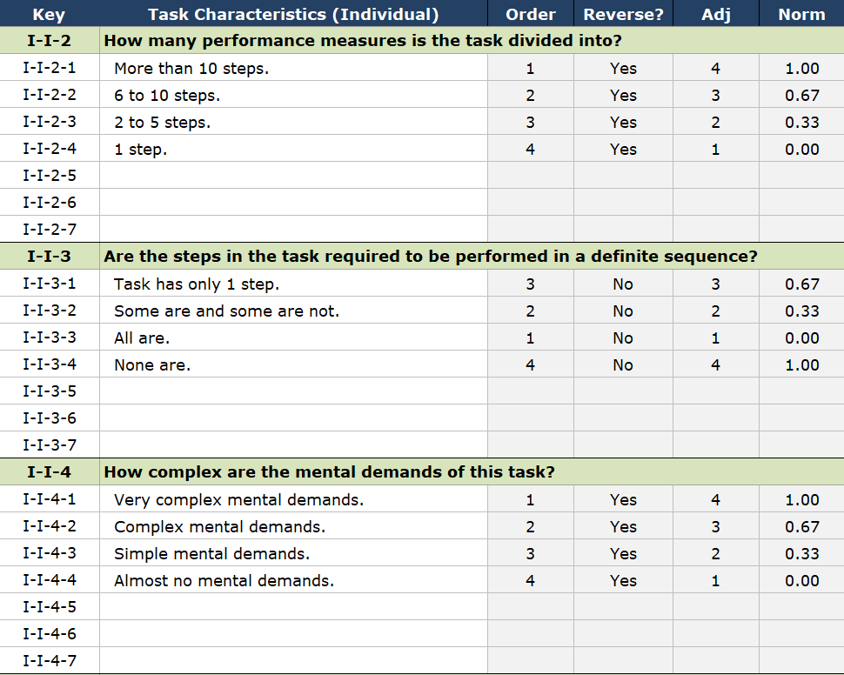
Scoring Step 1: Adjust Rating Scales and Response Options
 | Adjust the wording of the green rating scales as needed. Adjust the wording and number of response options under each scale as needed.
1
2
1
2
1
2
2
3
2

Slide 43
Scoring Step 2: Choose Settings in Order and Reverse Columns
 | Order Column: Change order of response options as needed for scoring purposes. Reverse Column: Indicate whether the scale should be reverse scored in the Reverse column. Adj/Norm Columns: Based on the settings in the Order/Reverse columns, the tool will automatically calculate the values in the "Adj" and "Norm" columns.
1
1
2
2
3
1
2
3
3

Slide 44
Data Collection Step 1: Enter Date, Name, and Desired Task to Rate
 | Enter current date in the following format (MM/DD/YYYY). Enter your first name and last name. Select the desired task from the Task Dropdown.
1
2
1
2
3
3

Slide 45
Data Collection Step 2: Rate Task on All Criteria
 | For each criterion, select the desired option from the dropdown menu. To view rating guidance for a particular criterion, double click on the corresponding question text. Select a confidence rating from the Confidence column. Enter an optional comment in the Comments column. Repeat the rating process for the remaining criteria. Scroll down to see all scales.
1
2
1
2
3
To view rating guidance, double click in the “Questions” column
3
4

Slide 46
Data Collection Step 3: Save Ratings to Database and Repeat
 | To save ratings to the database, click the “Click Here to Save Form” button in the top, right-hand corner of the form. The form will clear. To rate another task, select the desired task from the Task Dropdown and repeat the rating process.
1
1
2
2

Slide 47
Results Step 1: Select Chart and Export Results for Printing
 | Select the desired chart from dropdown menu in the top, left-hand corner of the tab. The chart area will dynamically update based on your selection. To ensure all tasks are fully visible for printing, click the “Autofit Rows” button. To hide blank rows in the table for printing, click the “Hide Blanks” button. To export the contents of the tab to a PDF for printing purposes, click the “Export Results to PDF” button.
1
1
2
3
4
2
3
4

Slide 48
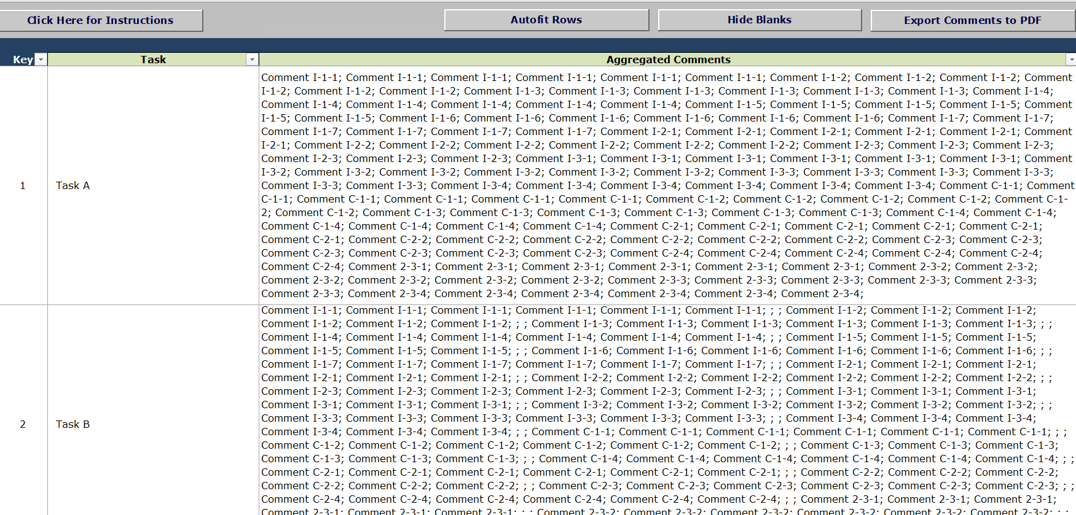
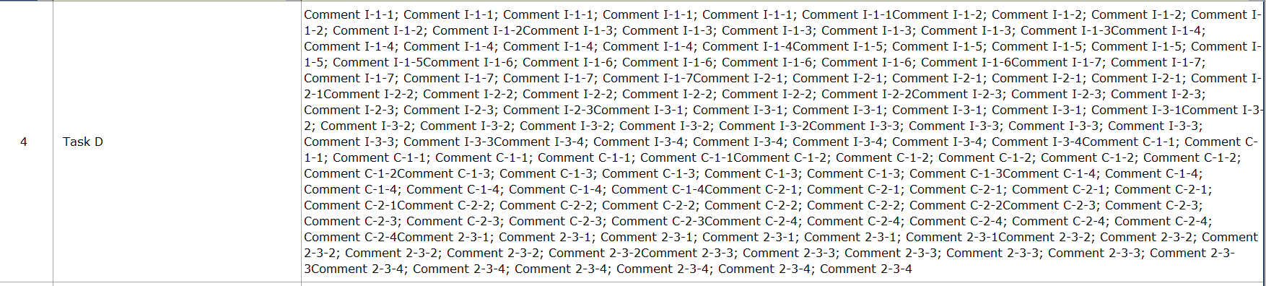
Comments Step 1: Filter, Sort, and Export Comments for Printing
 | To filter, search, and sort comments, click the down arrow (Autofilter) to the right of the desired header name. To ensure all tasks are fully visible for printing, click the “Autofit Rows” button. To hide blank rows in the table for printing, click the “Hide Blanks” button. To export the contents of the tab to a PDF for printing purposes, click the “Export Comments to PDF” button.
1
2
3
4
1
2
3
4

